Slide 1
Castration
Castration is defined as the destruction or removal of the testes, epididymis, and a part of spermatic cord from a male animal e.g. ram, buck, bull.
Castration causes sterilization (preventing the animal from reproducing); castration also greatly reduces the production of hormones, such as testosterone. Surgical castration in animals is often called neutering.

Slide 2
Castration
-Classification of Castration techniques
1-surgical (open or closed, prescrotal or scrotal ablation)
2-physical (bloodless methods of castration Burdizzo, and elastration)
3-chemical (formalin)
-surgical castration techniques
1-Prescrotal castration
A-Open prescrotal Castration.
B-closed prescrotal castration
2- Scrotal ablation: A-open B-closed

Slide 3
Burdizzo
Burdizzo
Because an incision is not required, castration by burdizzo is usually bloodless and, according to some research, has a lower risk of infection, compared with traditional methods.
The Burdizzo is a castration device which employs a large clamp designed to break the blood vessels leading into the testicles. Once the blood supply to the testicles is lost, testicular necrosis occurs, and the testicles shrink, soften, and eventually deteriorate completely. When the device is used, the operator crushes the spermatic cords one at a time, leaving a space in between in order to prevent an interruption of blood-flow to the scrotum. The burdizzo is used in cattle and sheep.

Slide 4
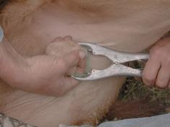
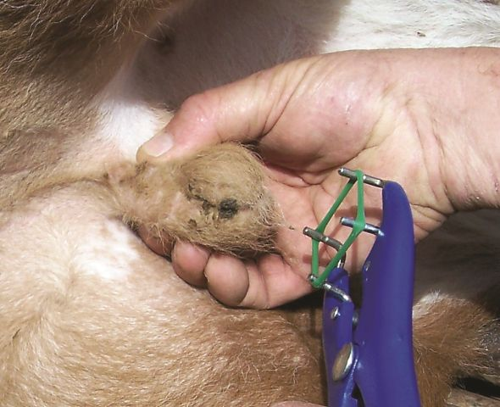
Elastration
elastration (rubber ring)
Elastration is a bloodless method of male castration commonly used for livestock. Elastration is simply banding the body part (scrotum or tail) until it drops off. This method is favored for its simplicity, low cost, and minimal training requirements.
Elastration is the most common method used in castrate sheep, goats, and cattle
Elastrator

